Slide 1
X-Ray Tube Heat Dissipation Modeling
Simulating Heat Generation & Dissipation Mechanisms

Slide 2
Team 14
Shehab Mohamed Hegab.
Mohamed Hazem.
Mohamed Aziz Hammam.
Mahmoud Emad.
Omar Mohamed Mahmoud.

Slide 3
Overview
Objective:
Analyze thermal behavior of an X-ray tube under operation.
Understand heat generation & dissipation mechanisms.
Use theoretical principles and numerical simulations for prediction.
Key Points:
X-ray tubes convert only ~1% of electron energy into X-rays; 99% becomes heat.
Effective cooling is crucial for performance and longevity.

Slide 4
01
Heat Generation

Slide 5
Heat Generation in X-Ray Tubes
X-ray tubes operate by directing high-energy electrons at a metal target.
Heat generation sources:
Joule Heating: Filament resistance heating.
Impact Heating: Electron collisions with the anode.
Secondary Radiation Heating: Absorption of secondary X-rays and electrons.
Only 1% of energy is converted into X-rays, while 99% is heat.

Slide 6
Heat generation formula
Parameters affecting X-ray tube efficiency:
kilovoltage peak (kVp).
Milliampere-seconds (mAs).
The heat generated in an X-ray tube can be calculated using the formula:
>> Q_heat = Efficiency Factor * (kVp) * (mA) * Exposure Time.

Slide 7
02
Heat Dissipation

Slide 8
Heat Dissipation Mechanisms
Radiation Cooling: Infrared radiation from the anode.
Conduction Cooling: Direct heat transfer through materials.
Convection Cooling: Air or liquid cooling systems (e.g., oil circulation).
Rotating Anode: Spreads heat over a larger area, reducing thermal stress.

Slide 9
Conduction mechanisms
Conduction is the process of heat transfer through materials.
In X-ray tubes, heat is conducted through components like the anode and casing.
>> Q = k ⋅ A ⋅ (T2 – T1) / L
The material’s thermal conductivity (k).
Surface area (A).
Temperature (T).
Effective path length (L).

Slide 10
Convection processes
Convection involves the transfer of heat to surrounding fluids, such as air or coolant, surrounding the X-ray tube.
The movement of these fluids aids in carrying away heat generated during X-ray production.
The rate of heat transfer can be described by the formula:
>> Q = h ⋅ A ⋅ (T2 – T1)
Heat transfer coefficient (h).
Surface area (A).
Temperature (T).

Slide 11
Radiation principles
Radiation heat dissipation occurs as the tube and its components emit infrared radiation due to their temperature.
This process is crucial for maintaining an equilibrium state within the tube.
The radiation transfer can be calculated using the formula:
>> Q = σ ⋅ A ⋅ ε ⋅ (T2^4 – T1 ^4)
Emissivity (ε).
The Stefan-Boltzmann constant (σ).
Absolute temperature (T).

Slide 12
Key Components of the Thermal Model
Physical Constants Used:
Stefan-Boltzmann Constant: 5.67×10⁻⁸ W/m²K⁴
Ambient Temperature: 22°C
Kelvin Offset: 273.15 K
Material Properties Considered:
Tungsten, Molybdenum, Copper
Thermal conductivity, specific heat capacity

Slide 13
Outcomes

Slide 14
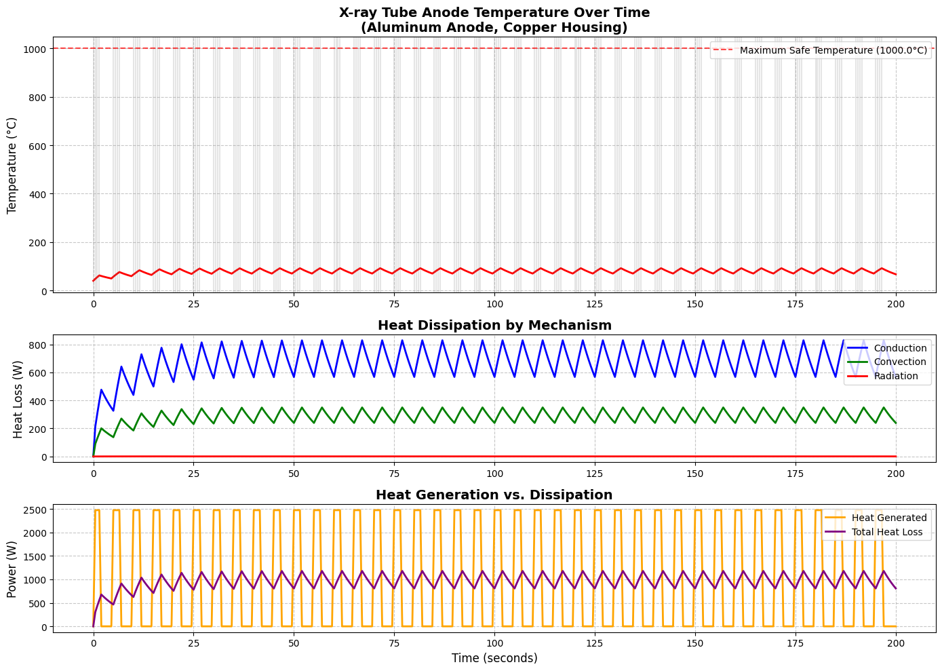

Slide 15
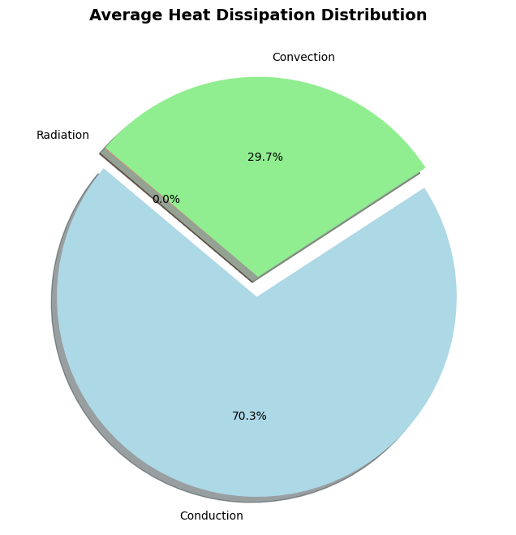
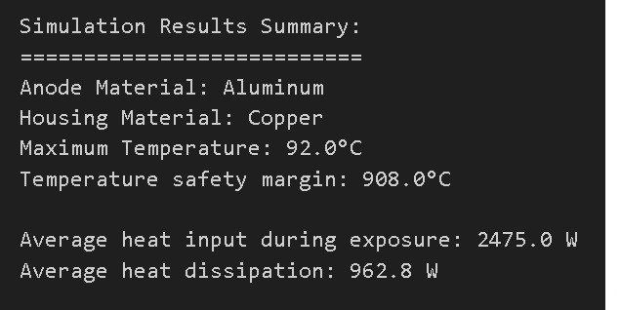

Slide 16
Thanks

